Slide 1

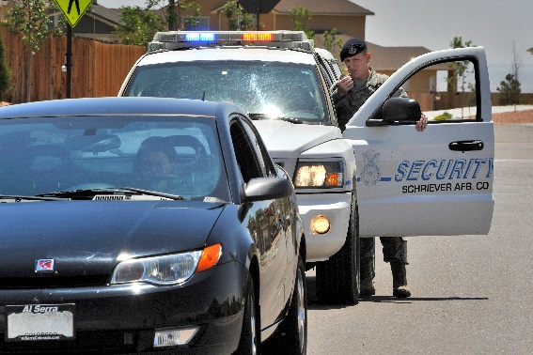

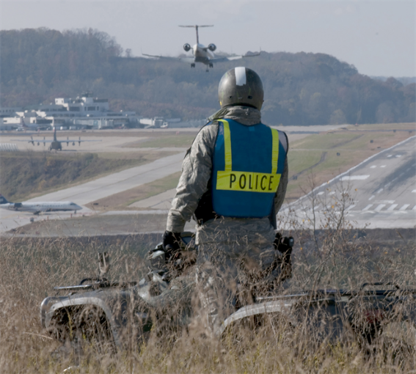
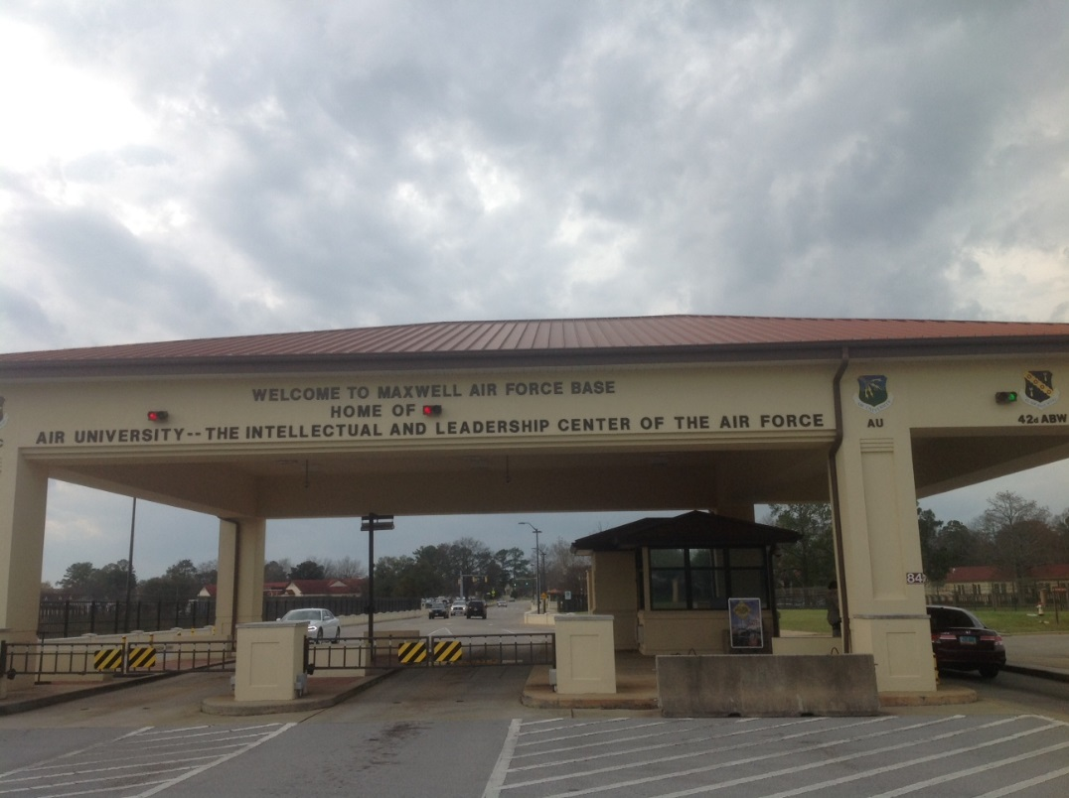
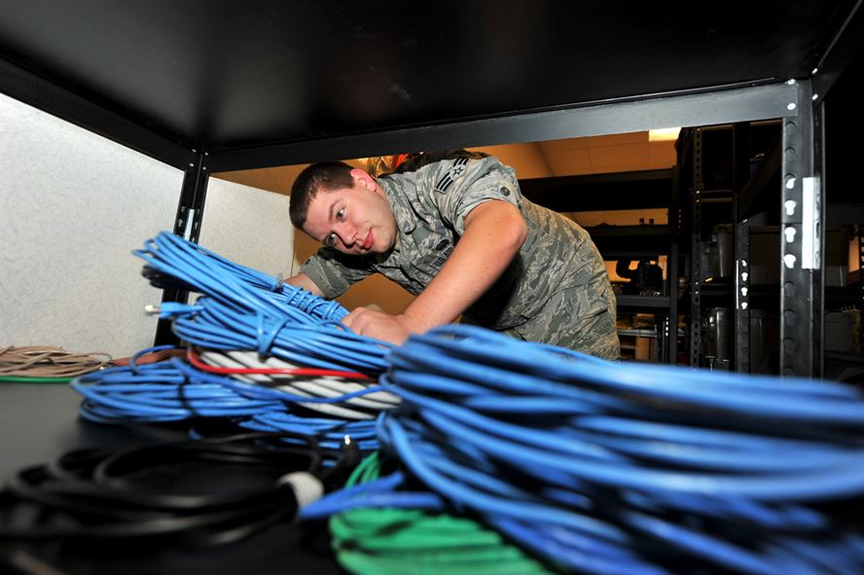
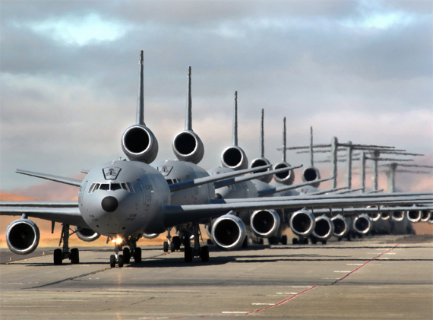
AT&T Taking the Smart City to the Base Tim Blount, Director Air Force Solutions Lenny Chin, Senior Application Solutions Consultant Andrew Osborn, Lead Mobile Solutions Architect Paul L Walker, Client Solutions Executive
Photos courtesy of the US Air Force
© 2017 AT&T Intellectual Property. All rights reserved. AT&T, Globe logo, Mobilizing Your World and DIRECTV are registered trademarks and service marks of AT&T Intellectual Property and/or AT&T affiliated companies. All other marks are the property of their respective owners. AT&T Proprietary (Internal Use Only). Not for use or disclosure outside the AT&T companies except under written agreement.

Slide 2
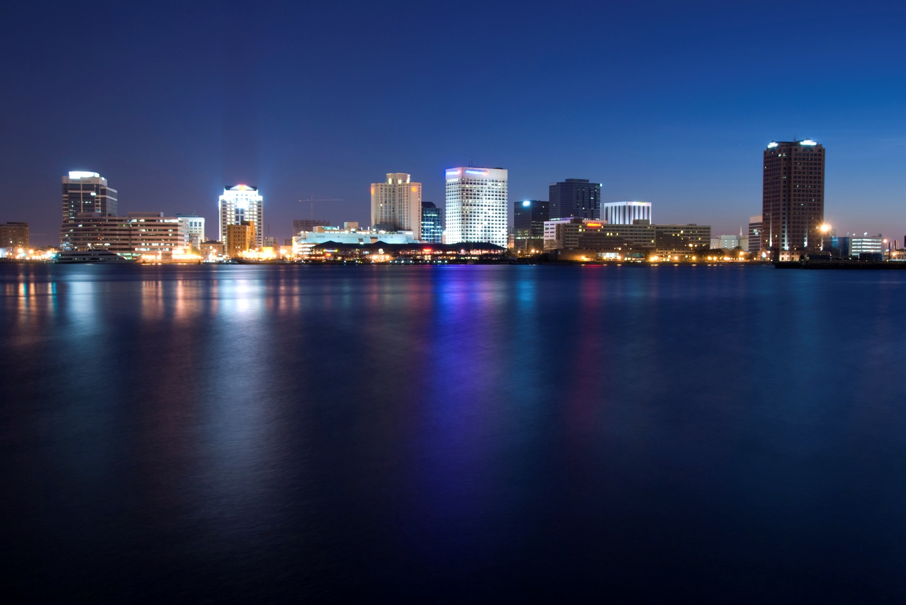
What is a Smart City?
Smart city is the integration of technology with a strategic approach to sustainability, cost reduction, citizen well-being and economic development.
International Electrotechnical Commission, 2014
Metering
Utilities
Security
Health
Vehicles
Equipment
Supply Chain
Homes
The future is smart cities
© 2017 AT&T Intellectual Property. All rights reserved. AT&T, Globe logo, Mobilizing Your World and DIRECTV are registered trademarks and service marks of AT&T Intellectual Property and/or AT&T affiliated companies. All other marks are the property of their respective owners. AT&T Proprietary (Internal Use Only). Not for use or disclosure outside the AT&T companies except under written agreement.
Notes:
Key messages:
No where is this more apparent than in smart cities
To us, this is the ‘nirvana’ where everything talks to everything and silos truly begin to blur
We’re still at the very beginning of this trend though
Requires investment and time to both prove value and build infrastructure to support
Might want to touch on doing it all securely here:
Multi-layered approach,
not WILL we have an attempted hacked, but how we will handle

Slide 3
Potential Areas of Opportunity
Energy & Utilities
Citizen Engagement
Transportation
Public Safety
Infrastructure
Water management
Smart Grid solutions
Smart lighting solutions
Leak detection
Private LTE network
Route optimization
Real time incident alerts
Smart parking & metering
Real time incident alerts
Drones
Public Wi-Fi hotspots
City ‘help/find’ Apps
Venue/event experiences
Enhanced PTT
Video Conferencing
Sensors
Emergency services
Video surveillance
Communication solutions
Gunshot detection
Smart buildings
Environmental monitoring
Municipal services
Smart Waste
Roads/bridges/ runway inspections
© 2017 AT&T Intellectual Property. All rights reserved. AT&T, Globe logo, Mobilizing Your World and DIRECTV are registered trademarks and service marks of AT&T Intellectual Property and/or AT&T affiliated companies. All other marks are the property of their respective owners. AT&T Proprietary (Internal Use Only). Not for use or disclosure outside the AT&T companies except under written agreement.
Notes:
Key messages:
High level focus areas
The cities that do not modernize and adopt operational and service management efficiencies will lose large numbers of people who will migrate to other cities that can promise a better quality of life and greater economic opportunities.

Slide 4
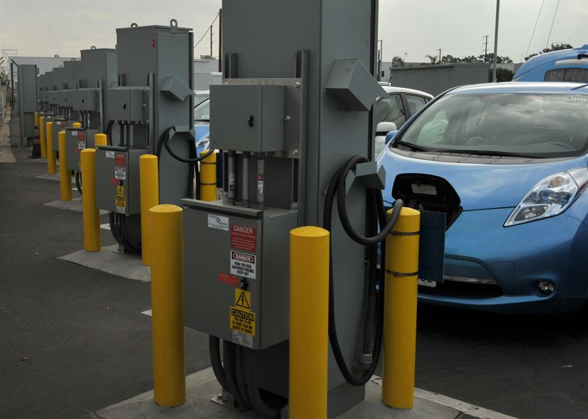
Photo courtesy of the US Air Force
Transportation
Keep forces moving
Traffic management – Connected Car (AT&T Drive Studio)
Smart parking – metering, monitoring and alerts
Mass transit – Bus and train schedules and service alerts
Fleet management – asset tracking, waste management, Cargo View
© 2017 AT&T Intellectual Property. All rights reserved. AT&T, Globe logo, Mobilizing Your World and DIRECTV are registered trademarks and service marks of AT&T Intellectual Property and/or AT&T affiliated companies. All other marks are the property of their respective owners. AT&T Proprietary (Internal Use Only). Not for use or disclosure outside the AT&T companies except under written agreement.
Notes:
Proof point use case examples:
Traffic management –
Smart parking –
Mass transit –
Fleet management – Cargo View with FlightSafe

Slide 5
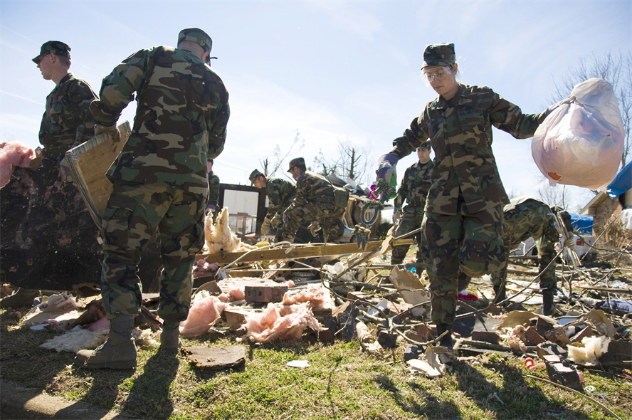
Photo courtesy of the US Air Force
Citizen engagement
Increase participation and information
LTE Wi-Fi
Connected citizen and engagement
Communication and information – city apps and alerts
© 2017 AT&T Intellectual Property. All rights reserved. AT&T, Globe logo, Mobilizing Your World and DIRECTV are registered trademarks and service marks of AT&T Intellectual Property and/or AT&T affiliated companies. All other marks are the property of their respective owners. AT&T Proprietary (Internal Use Only). Not for use or disclosure outside the AT&T companies except under written agreement.
Notes:
Proof point use cases:
LTE Wi-Fi – mobile network
Connected citizen – AT&T Messaging platform
Communication and information – city apps and alerts

Slide 6
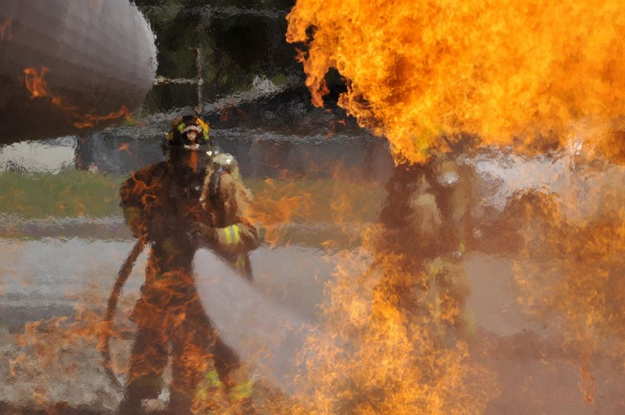
Photo courtesy of the US Air Force
Public safety
Optimize first responders
Sensors – gun shot spotter, air quality, seismic activity
Surveillance – fixed and mobile video, premise security, motion detectors
Asset management – people, vehicles, equipment
Communications – safe city emergency alerts
© 2017 AT&T Intellectual Property. All rights reserved. AT&T, Globe logo, Mobilizing Your World and DIRECTV are registered trademarks and service marks of AT&T Intellectual Property and/or AT&T affiliated companies. All other marks are the property of their respective owners. AT&T Proprietary (Internal Use Only). Not for use or disclosure outside the AT&T companies except under written agreement.
Notes:
Proof points use cases:
Video surveillance –
Vehicle tracking – fleet and field solutions
Asset management – workforce management
Communications – AT&T messaging

Slide 7
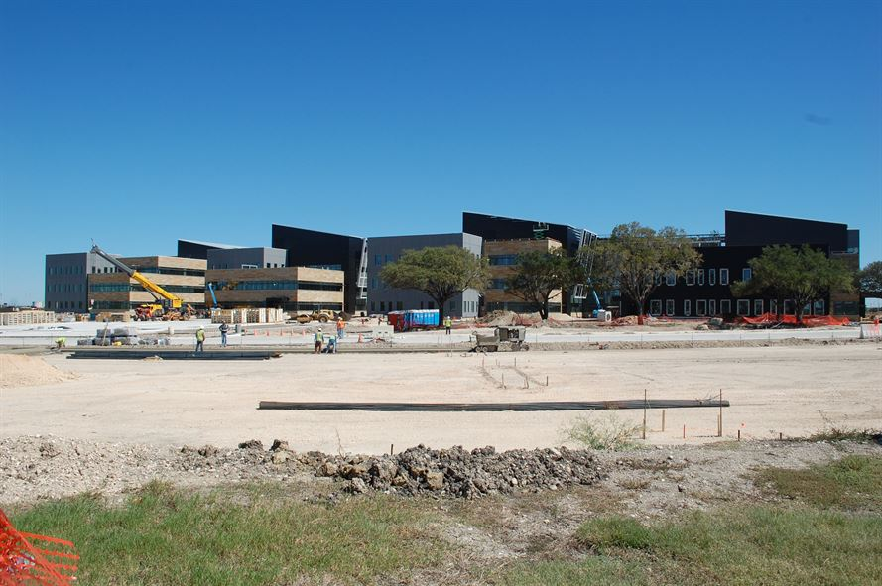
Photo courtesy of the US Air Force
Buildings and infrastructure
Smart management and maintenance
Smart buildings and lighting
Monitor and maintain bridges, roads and tunnels
Municipal services
Parks and public places
© 2017 AT&T Intellectual Property. All rights reserved. AT&T, Globe logo, Mobilizing Your World and DIRECTV are registered trademarks and service marks of AT&T Intellectual Property and/or AT&T affiliated companies. All other marks are the property of their respective owners. AT&T Proprietary (Internal Use Only). Not for use or disclosure outside the AT&T companies except under written agreement.
Notes:
Proof points use cases:
Buildings – Routers and gateways are used in buildings to connect lighting, temperature, HVAC systems, plumbing
Infrastructure - TBD
Municipal services – smart garbage bin
Parks and public places – AT&T messaging platform, mobility network, communications and information

Slide 8
© 2017 AT&T Intellectual Property. All rights reserved. AT&T, Globe logo, Mobilizing Your World and DIRECTV are registered trademarks and service marks of AT&T Intellectual Property and/or AT&T affiliated companies. All other marks are the property of their respective owners. AT&T Proprietary (Internal Use Only). Not for use or disclosure outside the AT&T companies except under written agreement.

